Slide 1
Lean Healthcare Concepts for Supervisors
_{15-LSUP-11A}
Air Academy Associates
Office: 719-531-0777
rmurrow@airacad.com
www.airacad.com

Slide 2
CONCEPTS for SUPERVISORS
Agenda
START at 9:00am and STOP at 4:00pm each day
Strategic View
  Self-Assessment
  Strategic Drilldown
  Planning Model
Lean Principles
  Value Stream
  8 Wastes
  Value Stream Mapping
  Input-Process-Output
  Measurements
  Exercise (1st Statapult)
  Variation and Process Capability
  DMAIC Methodology
  Process Flow
  Exercise (2nd Statapult)
  Tools (from Manager’s viewpoint)
    5S
    Standard Work
Notes:
2

Slide 3
CONCEPTS for SUPERVISORS
Agenda
  Tools (cont.)
    Visual Management
    Questions Leaders/Managers Need to Ask
    A-3 Thinking
    Gemba
    Analyzing Work
    Physical Process Map
    Process Control
Change Management
  Management Styles
  “Additional” Manager Roles
  Lean Deployment
  Breakout
Summary
Appendices
  Appendix A - Control Chart Examples
  Appendix B - DMAIC Tollgate Questions
  Appendix C - Rapid Improvement Events
Notes:
3

Slide 4

SELF-ASSESSMENT
Reality Check
What are you doing to enhance patient care while building a more efficient and effective healthcare system?
What measurements are you currently tracking?
What are your top 3 issues?
Notes:
4

Slide 5

SELF-ASSESSMENT (cont.)
Reality Check
What have you done in the last 6 months to address the issues?
Is there a need to improve?
What is your vision of the future?
What is your plan to get there?
Notes:
5

Slide 6
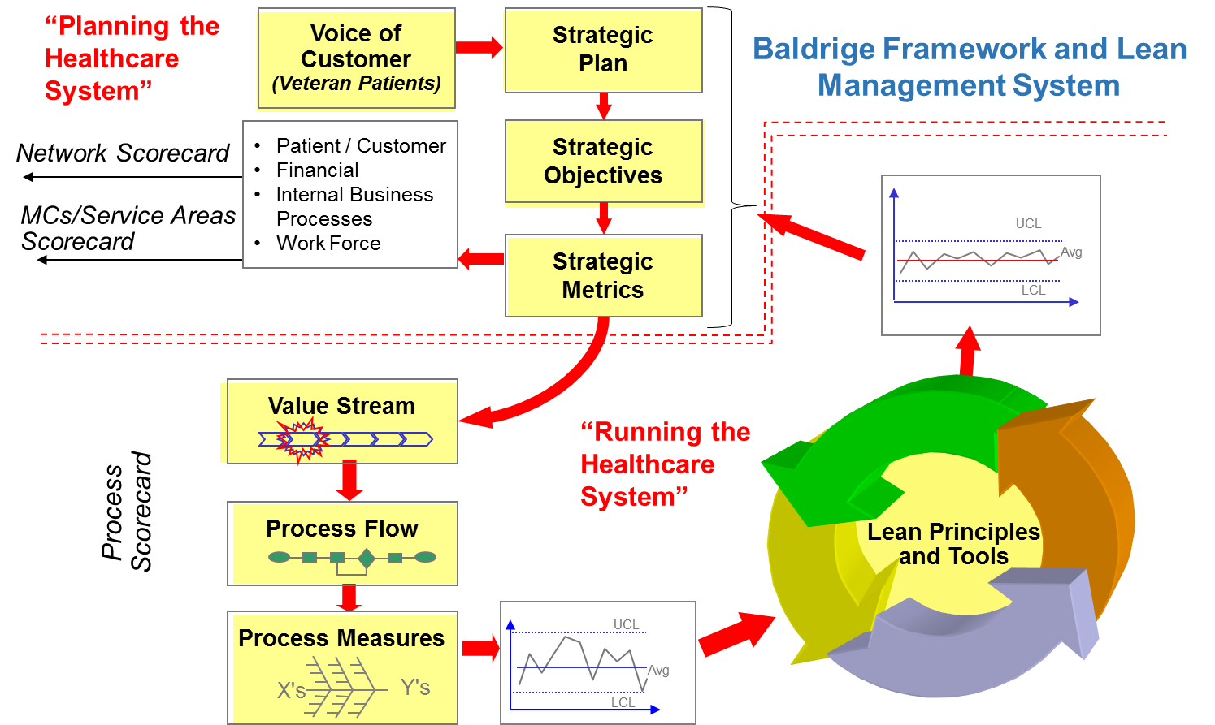
A STRATEGIC PLANNING MODEL
Improvement Efforts Should Link
“Planning the Healthcare System”
Lean Management System
(Internal/External)
Customer
Financials
Internal Business Processes
Work Force
Notes:
6
Specify value in the eyes of the Customer
Learn to see your processes from the perspective of your customer
Identify the value stream and eliminate waste/variation
Look at the combination of processes, not just a single process in isolation
Make value flow at the pull of the customer
Wait until you know what the customer wants before you start
Involve, align, and empower employees
Develop solutions using the people who are currently working in the process
Continuously improve knowledge in pursuit of perfection
Constantly challenge the organization to continue removing waste from processes

Slide 7
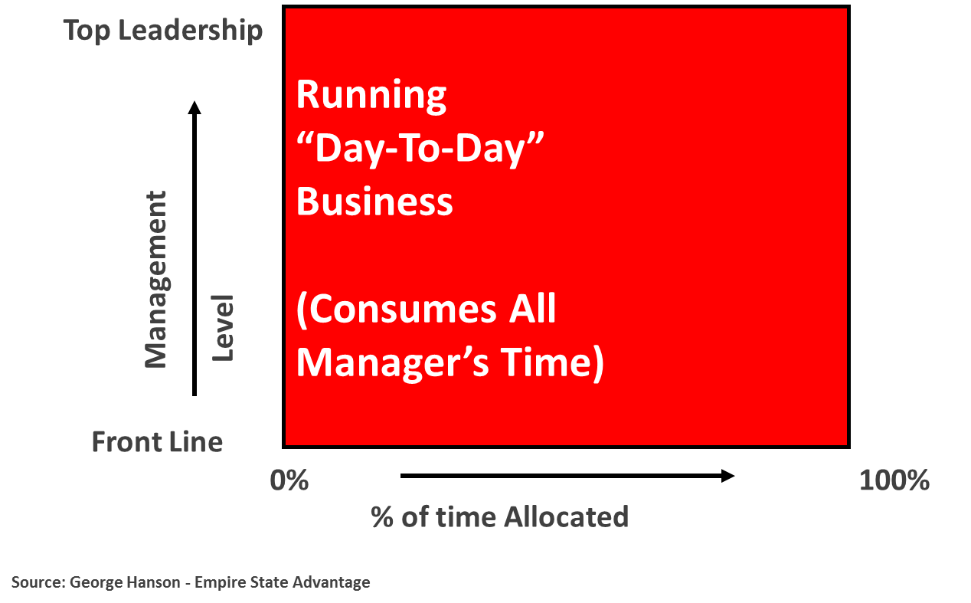
TIME ALLOCATION
In a “Chaotic” Organization
Source: George Hanson - Empire State Advantage
Notes:
7

Slide 8
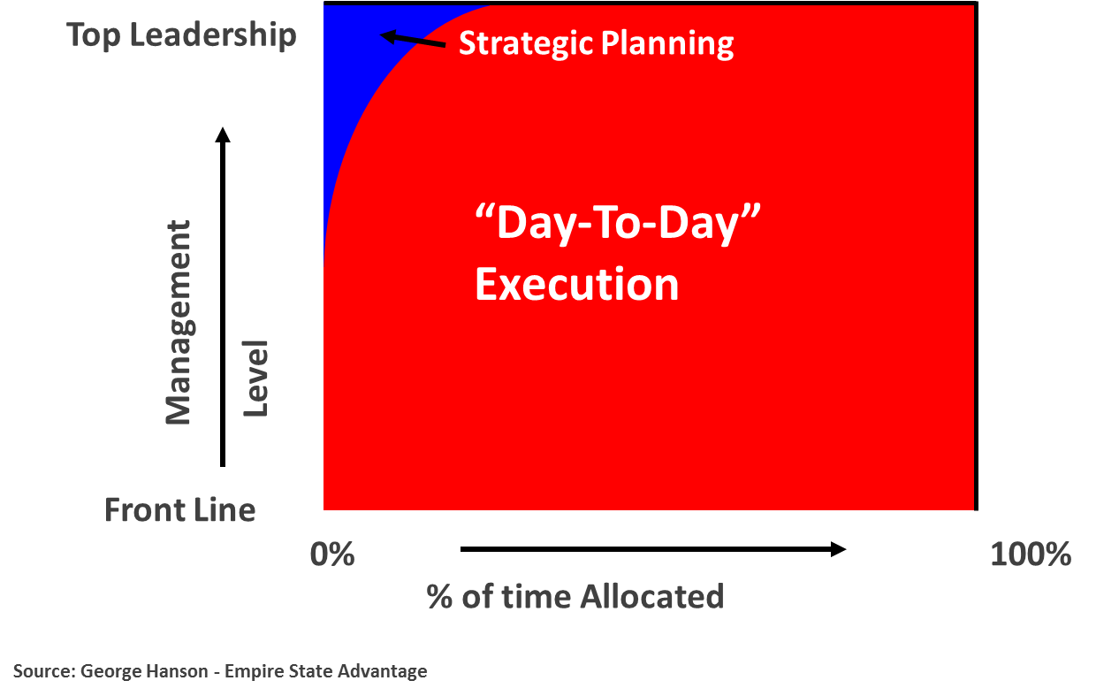
TIME ALLOCATION (cont.)
In a “Conventional ” Organization
Source: George Hanson - Empire State Advantage
Notes:
8

Slide 9
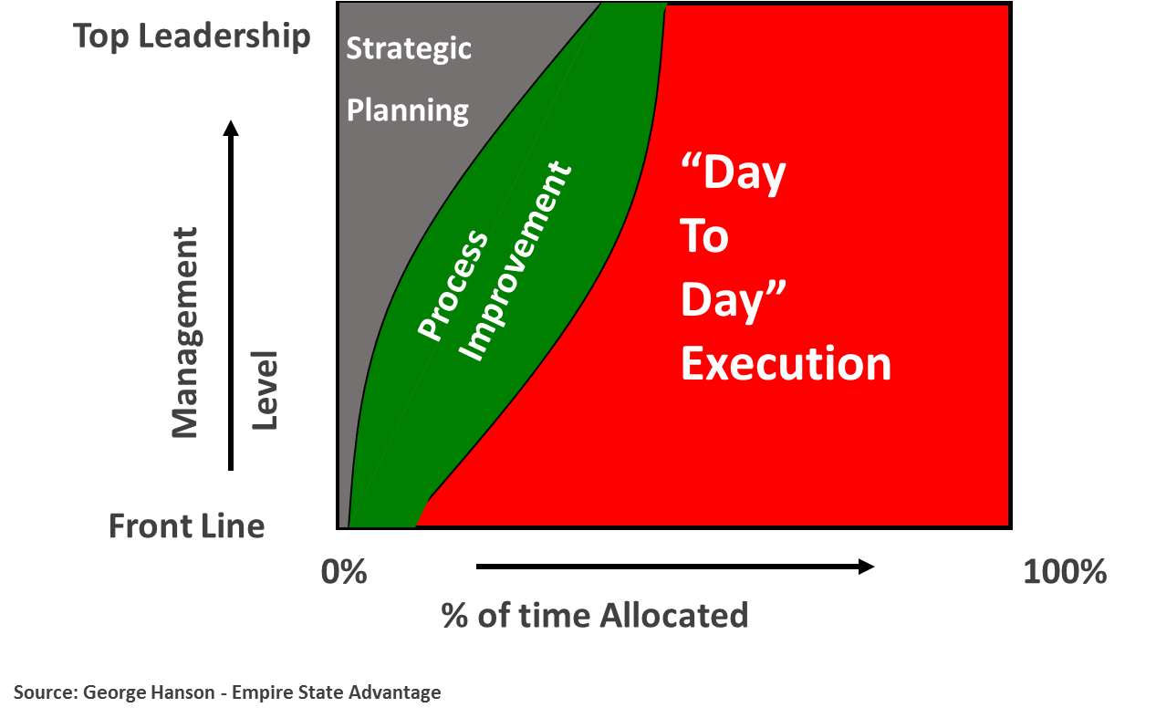
TIME ALLOCATION (cont.)
In a “World Class” Organization
Source: George Hanson - Empire State Advantage
Notes:
9

Slide 10
LEAN PRINCIPLES
Promote Performance Improvement
Specify value in the eyes of the Customer
  Learn to see your processes from the perspective of your customer
Identify the value stream and eliminate waste/variation
  Look at the combination of processes, not just a single process in isolation
Make value flow at the pull of the customer
  Wait until you know what the customer wants before you start
Involve, align, and empower employees
  Develop solutions using the people who are currently working in the process
Continuously improve knowledge in pursuit of perfection
  Constantly challenge the organization to continue removing waste from processes
Notes:
10

Slide 11
VALUE STREAM
Adds Value to the Customer
The VALUE STREAM is the entire set of activities performed to transform the products and services into what is required by the customer.
The VALUE STREAM
Suppliers
Procure
Prepare
Service
Follow-up
Customers
A Primary Focus is TIME
Product and / or Service Flow
Information Flow: Quickly In All Directions
Notes:
11
Specify value in the eyes of the Customer
Learn to see your processes from the perspective of your customer
Identify the value stream and eliminate waste/variation
Look at the combination of processes, not just a single process in isolation
Make value flow at the pull of the customer
Wait until you know what the customer wants before you start
Involve, align, and empower employees
Develop solutions using the people who are currently working in the process
Continuously improve knowledge in pursuit of perfection
Constantly challenge the organization to continue removing waste from processes

Slide 12
VALUE STREAM (cont.)
Types of Activities
Value Added Activities
Activities where the product or service is transformed into a state required by the customer.
Activities which, when asked, the customer is willing to pay for.
Non-Value Added But Required
Activities causing no value to be created but which cannot be eliminated based on current state of technology or thinking.
Non-Value Added Activities
Activities which consume resources but create no value in the eyes of the customer.
Pure Waste.
(VA)
(NVA-R)
(NVA)
Notes:
12
Specify value in the eyes of the Customer
Learn to see your processes from the perspective of your customer
Identify the value stream and eliminate waste/variation
Look at the combination of processes, not just a single process in isolation
Make value flow at the pull of the customer
Wait until you know what the customer wants before you start
Involve, align, and empower employees
Develop solutions using the people who are currently working in the process
Continuously improve knowledge in pursuit of perfection
Constantly challenge the organization to continue removing waste from processes

Slide 13

WHERE WASTE (MUDA) EXISTS
D-O-W-N-T-I-M-E
1. Defects
8. Extra processing
2. Over-production
7. Motion
3. Waiting
6. Incorrect inventory
4. Not utilizing employee ideas or initiative
5. Transportation
Notes:
13
Specify value in the eyes of the Customer
Learn to see your processes from the perspective of your customer
Identify the value stream and eliminate waste/variation
Look at the combination of processes, not just a single process in isolation
Make value flow at the pull of the customer
Wait until you know what the customer wants before you start
Involve, align, and empower employees
Develop solutions using the people who are currently working in the process
Continuously improve knowledge in pursuit of perfection
Constantly challenge the organization to continue removing waste from processes

Slide 14
EIGHT WASTES
Type of Waste | Description | Examples
Defects | Processes not performed correctly resulting in defects and/or rework | Surgical cart missing an item; wrong medication; incorrect patient information
Over-production | Doing more than what is needed by the customer | Unnecessary diagnostic tests; data fields larger than necessary
Waiting | Waiting for the next event or next work activity to occur | Waiting for equipment; waiting to move a patient to their room; waiting for approval
Non-productive use of people and ideas | Not utilizing employee talent or ideas “properly” | Burning high-talented workers out; putting people in “wrong” job positions; ignoring sound ideas
Notes:
14
Specify value in the eyes of the Customer
Learn to see your processes from the perspective of your customer
Identify the value stream and eliminate waste/variation
Look at the combination of processes, not just a single process in isolation
Make value flow at the pull of the customer
Wait until you know what the customer wants before you start
Involve, align, and empower employees
Develop solutions using the people who are currently working in the process
Continuously improve knowledge in pursuit of perfection
Constantly challenge the organization to continue removing waste from processes

Slide 15
EIGHT WASTES (cont.)
Type of Waste | Description | Examples
Transportation | Excess movement of materials, equipment, supplies, and patients | Poor ED layout resulting in the patient being moved from room to room; nurse station far from patients
Incorrect Inventory | Excessive inventory or inadequate inventory | Expired supplies; equipment parts obsolete; out-of-stock medications
Motion | Unnecessary movement and excessive walking of staff | Technicians walking miles per day due to location in facility; nurses walking miles per day looking for equipment or records
Extra Processing | Required work that is not of value | Asking for information on forms that is never used; same information required on multiple forms; collecting data never used
Notes:
15
Specify value in the eyes of the Customer
Learn to see your processes from the perspective of your customer
Identify the value stream and eliminate waste/variation
Look at the combination of processes, not just a single process in isolation
Make value flow at the pull of the customer
Wait until you know what the customer wants before you start
Involve, align, and empower employees
Develop solutions using the people who are currently working in the process
Continuously improve knowledge in pursuit of perfection
Constantly challenge the organization to continue removing waste from processes

Slide 16
VALUE STREAM MAPPING
Connection of Processes
Helps to visualize the entire system
Links the flow of activities with the flow of information (how the system is controlled)
Points out sources of waste
Highlights which steps are pacemakers (holding up other activities)
Allows selection and coordination of multiple improvement efforts in the same value stream
Notes:
16
Specify value in the eyes of the Customer
Learn to see your processes from the perspective of your customer
Identify the value stream and eliminate waste/variation
Look at the combination of processes, not just a single process in isolation
Make value flow at the pull of the customer
Wait until you know what the customer wants before you start
Involve, align, and empower employees
Develop solutions using the people who are currently working in the process
Continuously improve knowledge in pursuit of perfection
Constantly challenge the organization to continue removing waste from processes

Slide 17
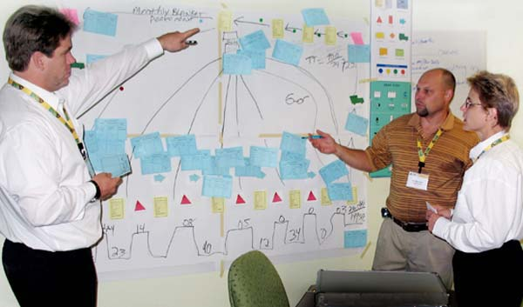
VALUE STREAM MAPPING (cont.)
Manual Mapping Example
Notes:
17
Specify value in the eyes of the Customer
Learn to see your processes from the perspective of your customer
Identify the value stream and eliminate waste/variation
Look at the combination of processes, not just a single process in isolation
Make value flow at the pull of the customer
Wait until you know what the customer wants before you start
Involve, align, and empower employees
Develop solutions using the people who are currently working in the process
Continuously improve knowledge in pursuit of perfection
Constantly challenge the organization to continue removing waste from processes

Slide 18
VALUE STREAM MAPPING (cont.)
Patient Care
Value Stream
Doctor Directive
Patient
Contacts
Appt Scheduled
Initial
Appt
Operation Scheduled
Lab work
Patient Admitted
Pre-op Care
OR Prepared
Surgery
Post-op
Recovery
Hospital Stay
Release Clearance
Discharge
Follow-up Care
Notes:
18
Specify value in the eyes of the Customer
Learn to see your processes from the perspective of your customer
Identify the value stream and eliminate waste/variation
Look at the combination of processes, not just a single process in isolation
Make value flow at the pull of the customer
Wait until you know what the customer wants before you start
Involve, align, and empower employees
Develop solutions using the people who are currently working in the process
Continuously improve knowledge in pursuit of perfection
Constantly challenge the organization to continue removing waste from processes

Slide 19
INPUT-PROCESS-OUTPUT (IPO)
Components of a Process
INPUTS
(Sources of Variation)
OUTPUTS *
(Measures of Performance)
      Accuracy
      Timeliness
      Cost Cost
People
Material
PROCESS
(Activity)
Perform a service
Equipment
X’s
Policies
Produce a Product
Y’s
Procedures
A blending of inputs to achieve the desired outputs
Methods
Complete a Task
Environment
* = Critical-to-Customer (CTC)
Notes:
19

Slide 20
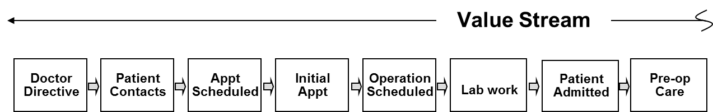
Input
Process
Output
Status of Patient
Performance Measures
(Quality, Timeliness, Cost)
Patient Info Requirements
Age
SSN
Address
Name
etc.
Admissions
Process
Patient Information Errors
Healthcare Insurance (?)
Q
Reason for Admission
Patient Satisfied
Q
Availability
Room
Timely Patient Admission
T
Bed
Staff
Attending Physician
Admission Cost per Patient
C
Bar Coding System
Documentation
Bar Code Bracelet
Q, T
Staff Member
Complete
Accurate
Time w/
Hospital
Training
Experience
Software
Forms
Policies

Slide 21
INPUT-PROCESS-OUTPUT (IPO)
Patient Safety Process
Patient (Demographics, health, etc.)
Facility
Patient Safety
etc.
Shifts
Incidents/staff
Location
Safety Training
Audit Program
Incidents/100 patients
Regulations
Time Between Incidents
Reporting System
Equipment
Cost / Incident
Staff
Incidents/department
Time w/ System
Safety Report
Experience
Training
Patient Safety Organization Alignment
Notes:
21

Slide 22
INPUT-PROCESS-OUTPUT (IPO)
Food Service Process
Patient Requirements
Soft
Liquid
Solid
Food
Service
Satisfy Requirements
Patient Input
Correct Temperature
Nutritious
Dietician
Nicely Displayed
Tasty
Physician Instructions
Documentation
Delivered Timely
Suppliers
Equipment
Cost / Meal
Food Preparers
Time w/ Provider
Waste
Experience
Training
Outsourcing
Notes:
22

Slide 23
INPUT-PROCESS-OUTPUT (IPO)
OR Preparation Process
Type Procedure
Pick List
OR
Preparation
Requested Room Layout
Operating Table
Deviations from Pick List
Stands
Surgeon
Deviations from Scheduled Time
Instrument Tray
Solutions
Waste ($)
Type
Pre-measured
Delivery Method
Multi-use Bottles
Supplies
Antibiotics
Drape Pack
Gloves
Towel Clips
etc.
Anesthesiologist
Training
Experience
Equipment
Time@Hospital
Notes:
23

Slide 24
INPUT-PROCESS-OUTPUT (IPO)
Your Process
Your Process
Notes:
24

Slide 25
SIPOC
IPO + Suppliers + Customers
A SIPOC diagram is an extension of a simple IPO diagram
It includes information about suppliers and customers
To create a SIPOC diagram:
  Name the process
  Identify the outputs and customers
  Identify the inputs and suppliers
Notes:
25

Slide 26
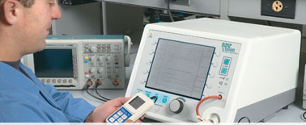
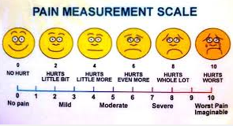
IMPORTANCE OF MEASUREMENTS
Beginning of Process Improvement
To assist good decision making
To identify/verify problem areas
To baseline a value stream or process
To characterize our processes (to know how inputs and outputs are related)
To see if our value streams and processes are improving
To determine if the patient care and improvement objectives are being realized

Slide 27
IMPORTANCE OF MEASUREMENTS (cont.)
Three Types
1. One-Time Measures
- To answer a question
- To solve a problem
2. Measures that Track Progress Towards a Desired Outcome
- Customer
- Employee
- Financial
- Internal Business Process
3. Measures used to Monitor a Process
- Baseline the process
- Determine improvement

Slide 28
IMPORTANCE OF MEASUREMENTS (cont.)
Examples
% New Mental Health appointments not seen within 30 days of create date
% billing code errors
% medication errors
% adverse clinical events (lab errors, needle sticks, surgery delays, etc.)
% New Primary Care appointments not seen within 30 days of create date
Patient complaint rate
Average # of adverse events/ICU day
% adverse events contributing to death
% ICU patients with defects on ID band

Slide 29
IMPORTANCE OF MEASUREMENTS (cont.)
Examples
% CT Scan effectiveness or requiring redo
% deviations from estimated Length of Stay (LOS)
% incorrect surgeries
% complications resulting from hip / knee replacement
% depression readmission rate
# hospital-acquired infections / 100 patient admissions
% services performed not authorized
# admittance errors / 100 patient admissions
Avg time for first appointment
% first-time appointments scheduled with wait-time exceeding one month

Slide 30
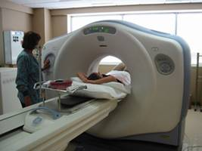
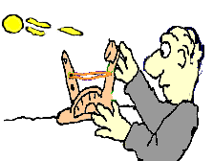
BASELINING THE PROCESS
Statapult Exercise
Statapult = Delivery Process
Ball = Service Provided
Setup = Job prep
Measurement = Outcome of the service

Slide 31
BASELINING THE PROCESS (cont.)
Collecting Data
Each participant must shoot Statapult® three times using the following steps:
(1) Insure all pins are at position #3
(2) Pull the arm to 177° and shoot the rubber ball
(3) Have someone measure your distance
(4) Disconnect rubber band between shots
(5) Your standard is no more than 15 seconds between shots
(6) Record distances and calculate Range (= longest – shortest)
#1
#2
#3
#4
#5
#6
#7
#8
#9
#10
Shot #1
Shot #2
Shot #3

Slide 32

THE VOICE OF THE PROCESS
Two Parameters
σ = Standard Deviation (variation)
y = Average (mean, balance point)
Concave Down
Inflection Point
Inflection Point
σ
Concave Up
y (CTC performance measure)
_
y ≈ 27
0
10
20
30
40
50
σ ≈ distance from the centerline to the inflection point
σ ≈ 37 – 27 = 10
̶ 32 ̶
Copyright, 2015:
Air Academy Associates

Slide 33
AVERAGE and VARIATION
Voice of the Process (VOP)
-6σ
-5σ
-4σ
-3σ
-2σ
-1σ
0
+1σ
+2σ
+3σ
_
y
+4σ
+5σ
+6σ
±1σ
27
±1(10) = (17-37)
68.27%
_
y
=
±2σ
27
±2(10) = (7-47)
95.45%
_
y
=
±3σ
27
±3(10) = (0-57)
99.73%
=
±3σ : Natural Tolerances of the Process
From example on previous page:
_
y=
σ
27
=
10

Slide 34
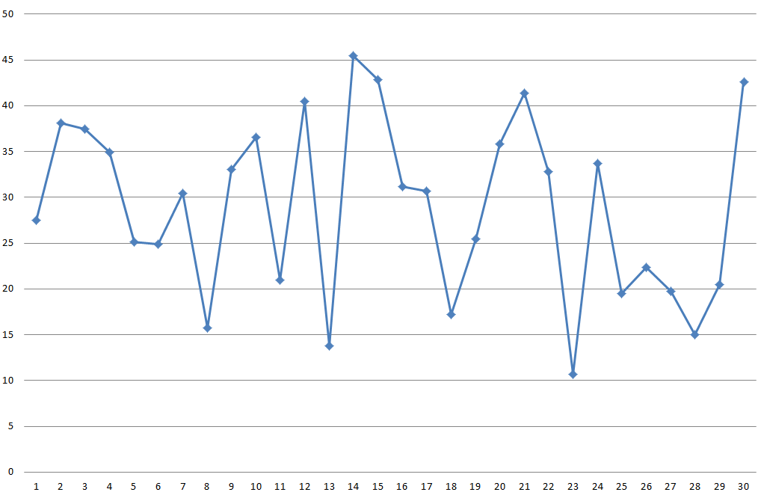
RUN CHART
Lead Time for Appointments
Run Charts Highlight Variation
Avg = 27.0
# Days
Patient
Notes:
34

Slide 35
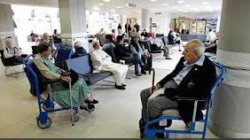

VARIATION IMPACTS PROCESS CAPABILITY
VOC vs VOP
The capability of a process is determined by comparing Voice of the Process (VOP) with the Voice of the Customer (VOC).
Lower
Requirement
Upper
Requirement
Determined by
the customer
Determined by
the customer
-6σ
-6σ
-5σ
-4σ
-3σ
-2σ
-1σ
0
+1σ
+2σ
+3σ
+4σ
+5σ
+6σ
Patients feel the VARIATION!
WASTE
WASTE
Reducing VARIATION improves process performance
-6σ
-5σ
-4σ
-3σ
-2σ
-1σ
0
+1σ
+2σ
+3σ
+4σ
+5σ
+6σ
Notes:
35

Slide 36
QUALITY PERFORMANCE MEASURES
Yield Rate
Step 1
Step 2
LS US
No Defect
(.80)
LS US
No Defect
(.90)
Desired End State
. .
Start
(.72)
Defect
Defect
(.20)
Defect
Defect
(.10)
Analyze
Analyze
*
*
_{Waste}
Fix
Fix
Every Time a Defect is Created During a Process (Step), it Takes Additional Cycle Time to analyze and fix.
* These Non-Value Added Activities Typically Require Additional Floor Space, Capital Equipment, Material, and People.
Notes:
36

Slide 37
LEAN METHODOLOGY
Systematic Approach to Improvement
Define
Measure
Analyze
Improve
Control
What is important to the customer:
Project Selection
Team Formation
Establish Goal
The process:
Analyze Data
Identify Root Causes
The process gains:
Ensure Solution is Sustained
The process performance measures:
Prioritize root causes
Innovate pilot solutions
Validate the improvement
How well we are doing:
Collect Data
Construct Process Flow
Validate Measurement System
Notes:
37

Slide 38
LEAN METHODOLOGY (cont.)
Potential Tools
Define
Measure
Analyze
Improve
Control
Voice of Customer
Project Charter
Project Scope
SIPOC
Waste
Physical Process Flow
Process Flow Diagram
Process Observation
Value Stream Mapping
Waste Analysis
Brainstorming
Cause & Effect Diagram
Pareto Chart
Root Cause Analysis
5 Whys
Rapid Improvement Event (Kaizen)
Mistake Proofing
PF/IPO/SOP
Standard Work
Visual Management
5S
Control Charts
Control Plan
Run Charts
SOPs
Notes:
38

Slide 39

IMPROVEMENT TOOLS
Reduce Variation, Defects, and Times
Define
Measure
Analyze
Improve
Control
PROCESS FLOW (PF) OR PROCESS MAP
INPUT - PROCESS - OUTPUT
STANDARD OPERATING PROCEDURES (SOP)
How What Who
_
_
_
_
_
_
_
_
_
_
_
_
_
_
_
_
_
_
_
_
_
_
_
_
_
_
_
_
_
_
_
_
_
̶ 39 ̶
Copyright, 2015:
Air Academy Associates

Slide 40
PROCESS FLOW
Improves Performance
Hospital Appointment Process
Patient calls
hospital
main number
Is an open
line available?
No
Patient told to
hold for 1st
available operator
Yes
Patient describes
type of care
required
Operator
transfers patient
to appropriate office
Emergency
Room
(E.R.)
Family
Practice
Acute Minor
Illness Clinic
Optometry
E.R. personnel
consult patient
Appointment
made
Appointment
made
Appointment
made
Notes:
40

Slide 41
INPUT – PROCESS - OUTPUT
Improves Performance
Environment
Measurement System
Statapult
Data Collection Plan
Personnel Schedule
Positions
Ball Type & Placement
Materials (duct tape, etc.)
Distance
Operator
Time in job
Training
Experience
Release Technique
Consistent
Timing
Smooth
Statapult
Pin Height
Stop Angle
Start Angle
Rubberband
Notes:
41

Slide 42
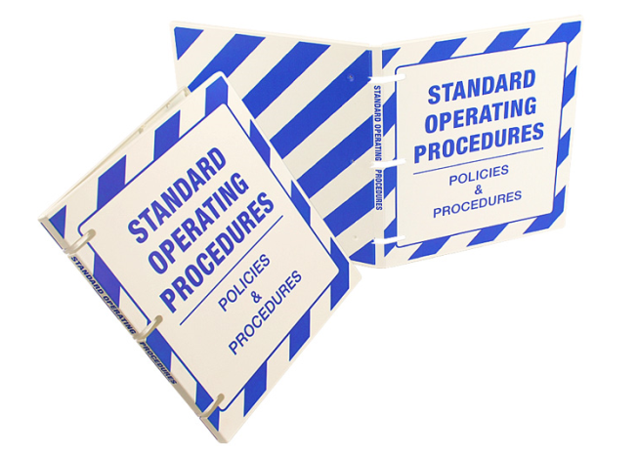
STANDARD OPERATING PROCEDURES (SOPs)
Improve Performance
Define the interaction of people and their environment when performing a service
Detail the action and work sequence of the worker
Provide a routine to achieve consistency within the process
Specify the best process we currently know and understand for controlling variation
Provide a basis for future improvements
Validate mistake proofing in the process
Notes:
42

Slide 43
IMPROVE THE PROCESS WITH PF/IPO/SOP
Second Statapult Exercise
(1) Process flow "Shooting the Statapult®"
(2) Complete Cause-and-Effect Diagram
(3) Label inputs as C or N
(4) Write simple SOPs for all C's
(5) Re-shoot Statapult® using the first example instructions (all pins at #3; pull angle = 177°; 15 sec. between shots; etc.)
(6) Record data taken after PF/CE/CN/SOPs
(7) Evaluate current process variability
#1
#2
#3
#4
#5
#6
#7
#8
#9
#10
Shot #1
Shot #2
Shot #3
Range = Longest - Shortest =
Notes:
43

Slide 44
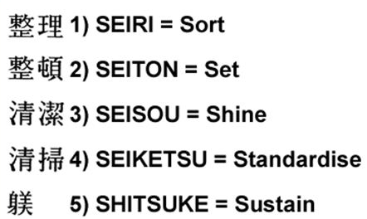
5S
From Shop Floor to Office
Organize the workplace …5S
1. Sort - Identify what forms, equipment, parts, etc. are needed (keep) and what is not (remove)
2. Set in Order - Determine a place for needed items … identify the storage place with clear markings
3. Shine - “Clean” the office/room/station and maintain the equipment
4. Standardize - Work procedures, systems, and policies
5. Sustain - Review regularly the SOPs, processes, regulations, etc. and ensure compliance
S
A
F
E
T
Y
Leaders and Managers Make It Happen!
Provide documentation so that the work environment is clearly defined, self-regulating, and self-improving
Notes:
44

Slide 45
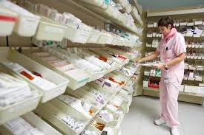
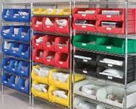
5S
Sort
Guidelines
How often is it used? | Storage Location
Hourly | Within arm’s reach
Every Shift | Within a short walk
Daily | Further away (but convenient)
Monthly | Department storage
Annually | Facility storage
Never | Get rid of it
Notes:
45

Slide 46
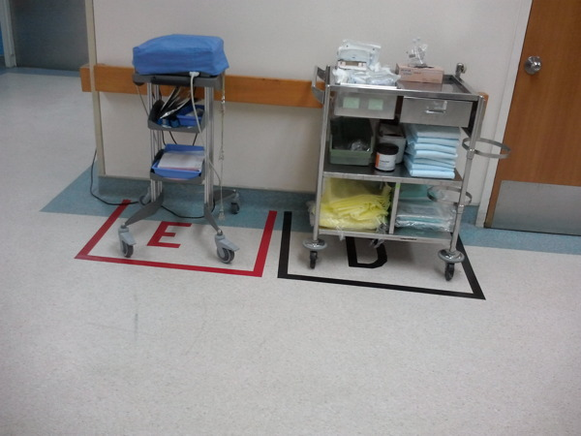
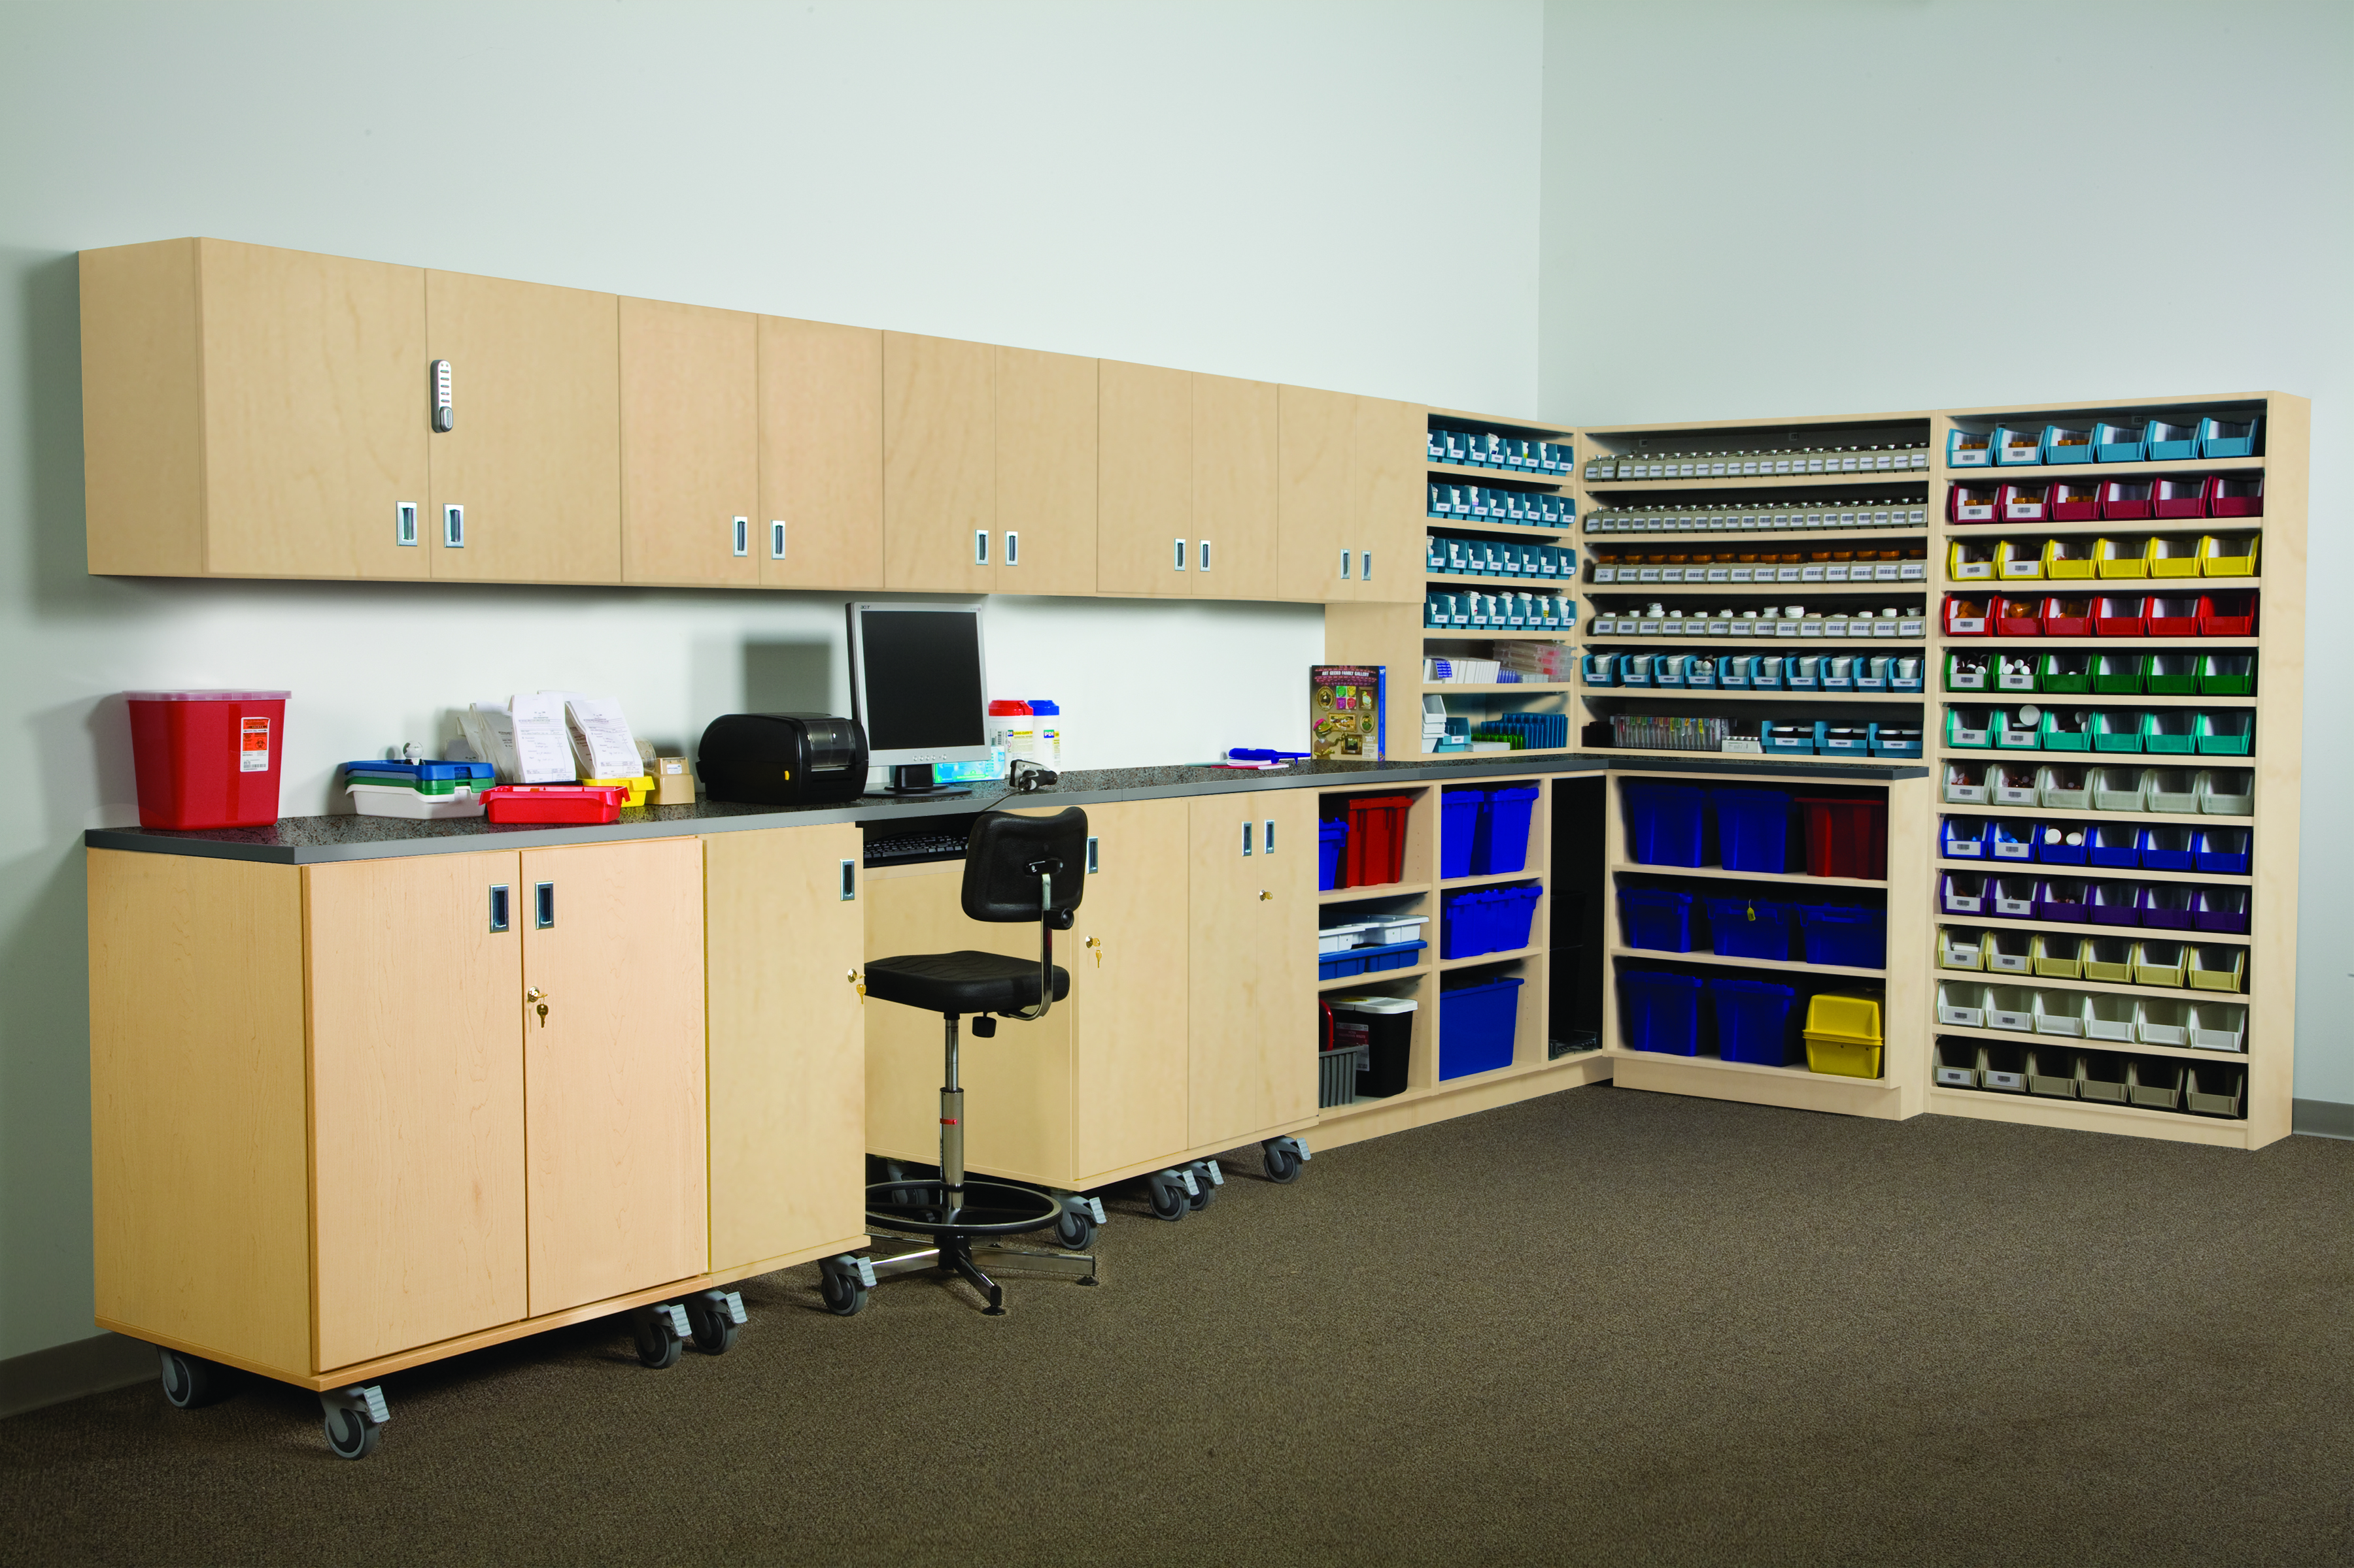
5S
Set in Order
Physically reconfigure the area for optimization
Mark locations for carts, big equipment, unit storage, etc.
Designate location for paperwork, medications, materials, and supplies
Build racks, containers or shadow boards for frequently used items
Place frequently used items near primary work locations
Notes:
46

Slide 47
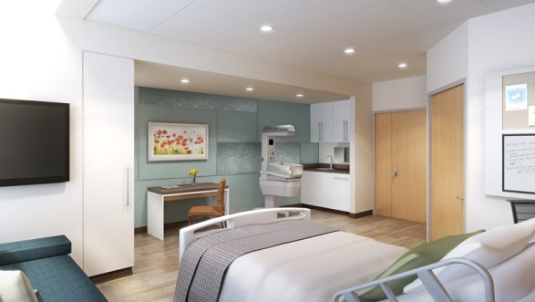
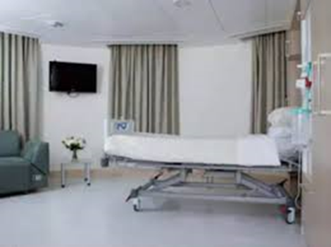
5S
Shine
Clean floors, walls, tools, and equipment
Repair/replace items that could cause future cleanliness problems
Repair faulty electrical outlets, cracks, items with excessive wear, etc.
Paint areas if necessary
Provide proper cleaning tools and procedures to maintain the improved condition
Ensure that proper collection methods exist for debris and trash
Notes:
47

Slide 48
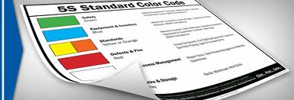
5S
Standardize
Document the process and procedures with checklists, guidelines, flowcharts, diagrams, photographs, etc.
Implement visual management …color
coding, checklists, labeling, etc.
Ensure that everyone is properly trained on the current process and standard operating procedures
Determine and document responsibility towards achieving this step
Communicate the necessity to embrace 5S and provide any necessary 5S training
Notes:
48

Slide 49
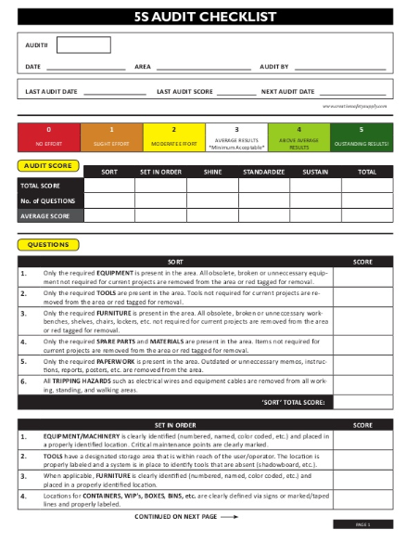
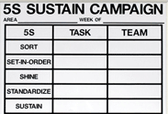
5S
Sustain
Develop a 5S audit capability
Identify roles and responsibilities
Review regularly the SOPs, processes, regulations, etc. for currency and compliance
Develop a process to ensure compliance (audit, frequency, etc.)
Utilize standard written procedures and check sheets
Reward and recognize success
Notes:
49

Slide 50
STANDARD WORK
Improves Efficiency
  Method for improving work efficiency by:
    Designing the best method to complete a work task
    Documenting the method
    Training operators, technicians, nurses, etc. to do the same work task using the same method
  Steps to develop standard work routines:
    Step 1: Involve those performing the process to analyze the work task by breaking it down into work components … understand the current process
    Step 2: Sequence the steps in a logical and efficient order … use good ergonomic principles of human motion
Notes:
50

Slide 51
STANDARD WORK (cont.)
Improves Efficiency
  Steps to develop standard work routines (cont.):
    Step 3: Capture appropriate times for the completion of the steps
    Step 4: Document with procedures, diagrams, and layouts
      Use visual methods such as photographs, Powerpoint, and schematics whenever possible
      Keep task descriptions clear and simple
      Present the work steps in the sequential order in which they must be performed
      Develop using a team approach combining the best practices in a safe and efficient way to complete the task at a sustainable pace
Notes:
51

Slide 52
STANDARD WORK (cont.)
Improves Efficiency
  Steps to develop standard work routines (cont.):
    Step 5: Review the procedures with all who perform the process and revise as necessary
      Standard Work is not permanent and should be reviewed regularly for improvement
    Step 6: Train those who work the process by demonstration with the documents as aids
      Follow up with “hands-on” training and a review for competency
    Step 7: “Audit” at all levels regularly and ensure standard work is current
Notes:
52

Slide 53

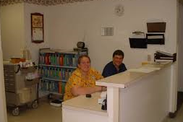

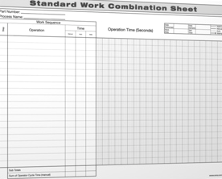

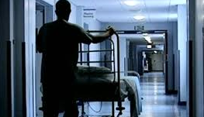

STANDARD WORK (cont.)
Needed At All Levels
Notes:
53

Slide 54
STANDARD WORK (cont.)
Benefits
  Standard Work:
    Predictable quality and predictable cycle time for the task
    Efficiency gains with reduction in variability
    Standardizes the method with standard operating procedures (SOPs)
    Enhances competencies
    Enhances problem solving
    Strengthens multi-skilling
    Details the interactions between the people (nurses, technicians, etc.) and the equipment/computers used for the process
Notes:
54

Slide 55
STANDARD WORK (cont.)
Exercise
  Work as individuals or on a team (4-6 people)
  Pick a process
    Making coffee
    Shopping for groceries
    A process from within a MC value stream
  Complete the Standard Work Template (next page)
  Prepare a debrief
Notes:
55

Slide 56
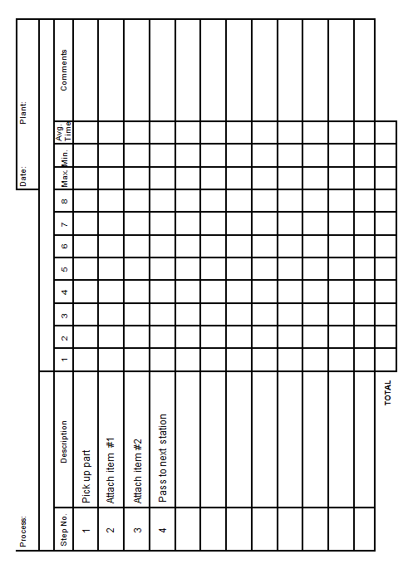
STANDARD WORK (cont.)
Standard Work Template
Notes:
56

Slide 57
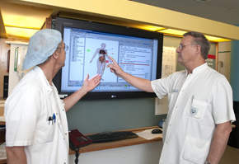
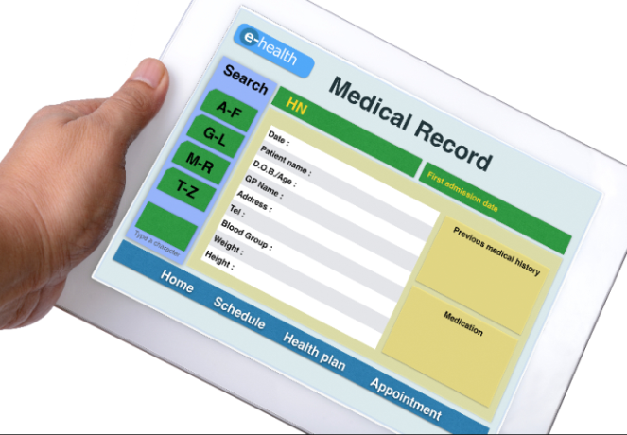
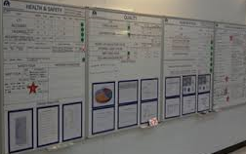
VISUAL MANAGEMENT
Benefits
Used to:
  Support Leadership and Management
    Displays work priorities
    Daily process performance
    Enhances communication
  Provide current status/information
  Standardize
  Error Proof
    Prevents process omissions
    Supports correct process step completion
Notes:
57

Slide 58
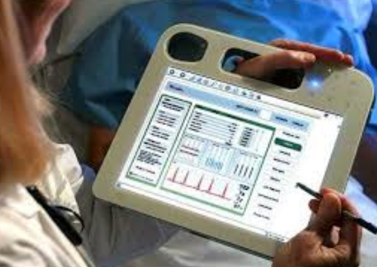
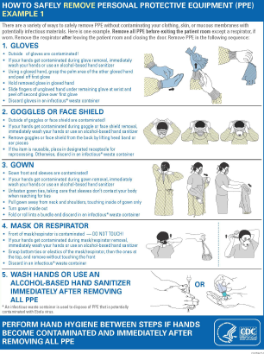
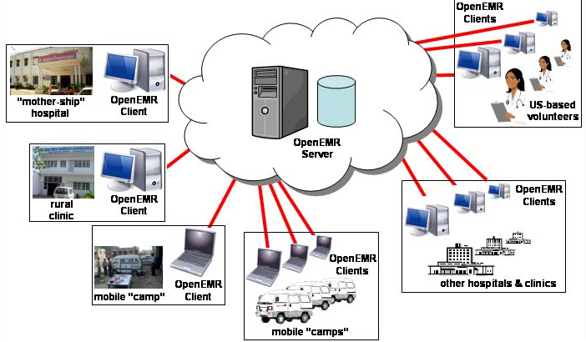
VISUAL MANAGEMENT (cont.)
Benefits
Promotes:
  Better patient outcomes
  Safety
  Training and standards
  Better job performance
  Good process control (less variation)
Notes:
58

Slide 59
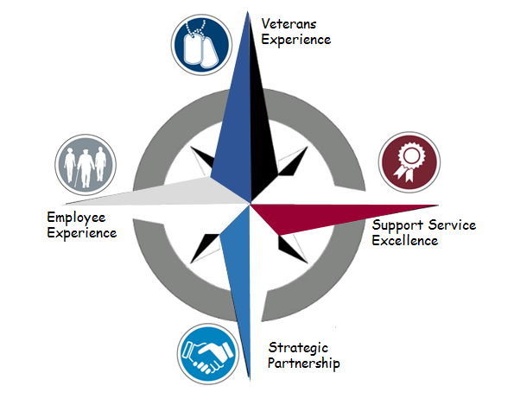
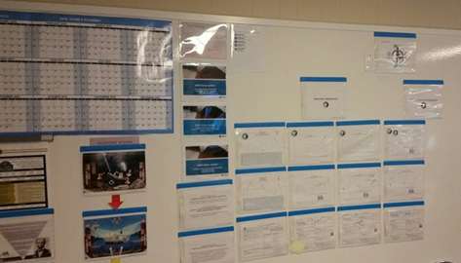
VISUAL MANAGEMENT (cont.)
Examples
Strategic View
True North Metrics
Notes:
59

Slide 60


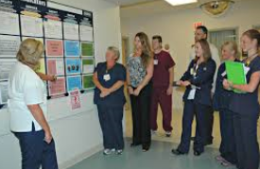
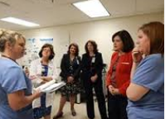



WHAT’S HAPPENING HERE?
List Common Characteristics
7
5
4
1
6
2
3
Notes:
60

Slide 61
HUDDLE BOARD MEETINGS
A Powerful Tool for Leaders/Managers
Attended by:
  Leaders/managers (typically, leads the meeting)
  Team members/staff/process workers (responsibility for leading or facilitating the huddle can be rotated)
Promotes:
  Efficient use of meeting time (normally limited to 15 minutes)
Provides:
  Current status
  Daily direction
  Strategic alignment
Facilitates:
  Quick and accurate communication
  Performance and process improvement
Notes:
61

Slide 62
HUDDLE BOARD MEETINGS
A Powerful Tool for Leaders/Managers
Facilitates (cont.):
  Prioritization of effort
  Self-management
  Making adjustments and improvements to daily work practices
Topics discussed:
  Selected by leaders/managers
  Related to organizational strategy and priorities
Candidate topics include:
  Hot issues
  Metrics and goals
  Current plan to meet goals
  Day’s top priorities
Notes:
62

Slide 63
HUDDLE BOARD MEETINGS (cont.)
A Powerful Tool for Leaders/Managers
Candidate topics include (cont.):
  Problems faced
  Help needed
  Safety issues
  Performance issues
  Potential improvement efforts/events
  Training on updated/new processes
Fosters:
  Recognition
  Communication
  Efficiency
  Culture of unity
  Trust and respect
Notes:
63

Slide 64
HUDDLE BOARD MEETINGS (cont.)
A Powerful Tool for Leaders/Managers
Success enhanced by:
  Starting on time
  Ending on time
  Holding regularly (even if it’s a busy day)
  Sticking to the agenda or format
  Not turning the huddle into just a “status report”
  Leadership/management direction
Notes:
64

Slide 65
PROCESS IMPROVEMENT QUESTIONS
Questions Leaders/Managers Need to Answer
How do you know that waste and quality issues are important to your organization? Which ones are a priority and why are they so important?
How do you know your organization’s current level of quality and performance? How do you know that improvement efforts can assist you in increasing quality, improving performance, and reducing waste?
How are you actively pursuing breakthrough as well as continuous improvement in your areas of responsibility that link to customer value?
What portion of your time do you spend devoted strictly to the removal of waste and variation?
What are your products and services and who are your customers? How do you learn the value created for each customer? What is your process for soliciting feedback from your customers? What do you do with the feedback?
Notes:
65

Slide 66
PROCESS IMPROVEMENT QUESTIONS (cont.)
Questions Leaders/Managers Need to Answer
What is your process for soliciting feedback from the people you manage? What kind of feedback do you solicit? What do you do with the feedback?
How do you measure, analyze, review, and improve performance by using data and information?
What are the right knowledge-generating and improvement-oriented questions you need to ask the people who work for/with you? What methods or tools can be used to answer them?
To what extent have you deployed and implemented an improvement strategy with a disciplined methodology and toolset and associated infrastructure to predictably generate higher levels of efficiency and effectiveness?
Notes:
66

Slide 67
PROCESS IMPROVEMENT QUESTIONS (cont.)
Questions Leaders/Managers Need to Answer
How do you assure that your workforce is properly trained to successfully use the latest and best improvement methodologies and tools?
How would you describe the Cost of Poor Quality in your area of responsibility? How is it calculated? How are efforts to eliminate it identified and prioritized? How do you calculate the Return on Investment (ROI) from your improvement efforts (including eliminating the Cost of Poor Quality, project resources deployed, and training?
Do you have a standard procedure for documenting the improvement efforts and results? What is it?
What barriers does your workforce face when trying to improve the way your organization does business? What are you doing to remove these barriers?
Notes:
67

Slide 68
PROCESS IMPROVEMENT QUESTIONS
Questions Leaders/Managers Need to Answer
On what measures of performance, related to these issues, are you evaluated? How are you held accountable for the measures of performance? What are the specific improvement goals for them? How do you hold your workforce accountable?
What kind of plan do you have that will, one year from now, show evidence that you made a difference? What do you predict that evidence will show?
Notes:
68

Slide 69
ANALYZING WORK
Enhances Performance
In our processes, we must challenge ourselves to:
  Analyze the work being done
  Understand the types of activities being performed (VA, NVA, NVA-R)
  Strive to eliminate or reduce the non-value added work
Where’s the gap? What’s the problem?
  Cycle times too long
  Changeover times too long
  Excessive variation
  High defect rates
  Excessive waiting
Notes:
69

Slide 70
ANALYZING WORK (cont.)
Enhances Performance
Identify the potential causes of the problem
Tools for analyzing work include:
  Process map (previously addressed)
  Observation (Gemba Walk)
  Brainstorming
  5 Whys
  Pareto Chart
  Physical Process Map
Notes:
70

Slide 71
GEMBA WALK
Observation
Gemba is a Japanese term for “the real place”
  Where work is being done and value is created
Why perform Gemba Walks?
  Required by top leadership?
    Frequency, coverage, goals, etc.
  Enhances leaders/managers capability
  Helps problem-solve
  Provides first-hand view/knowledge … get away from the office/desk
  Fosters conversations with “your” people who work the processes
On a Gemba Walk leaders need to answer:
  What is the process?
  How do I know it is working?
  What can I do to help improve the process?
Notes:
71

Slide 72
GEMBA WALK
A Leadership/Management Tool
Things to observe and to discover on the Gemba Walk
  How processes are accomplished (enables completion of a process map)
  What activity is Value Added and what is Non-value Added
  How upstream and downstream processes are performing
  Safety
  Ergonomics
  Layout
  Equipment status (maintenance and performance)
  Consistency of work accomplishment (does variation exist?)
  Validity of measurements (are they tracked real-time?)
  Patient activity and wait time
Notes:
72

Slide 73
GEMBA WALK (cont.)
A Leadership/Management Tool
    Chokepoints
    Compliance with Standard Work/Standard Operating Procedures
    5S
    Waste
    Visual Management
    Problems with the process
      Cycle times too long
      High defect rates
Notes:
73

Slide 74
GEMBA WALK
Points To Remember
Start with a purpose in mind (see previous slides)
  Know what you want to observe
  Know what you want to learn
  Know if there are any problems
Know the people who are involved in the process
Observe intently … the facility, the process, the equipment, the people, etc.
If problem solving, drill for Root Cause (use 5 Whys)
Validate and verify … ask yourself, “is the observation what I would normally see?”
Listen, listen, listen
Perform Gemba Walks
Notes:
74

Slide 75
BRAINSTORMING
Helps in Decision Making
What is it?
  Brainstorming is used for generating many ideas that team members can build upon in a non-critical environment
Why use it?
  Brainstorming engages all members of the team by treating each idea equally
  Team members are able to pool their knowledge
  Creative ideas are formed by building off of other’s ideas
When should it be used?
  Brainstorming should be used when the problem can be solved using existing knowledge
  Brainstorming can also be used as an opening step for other methods of creativity
Notes:
75

Slide 76
BRAINSTORMING (cont.)
Helps in Decision Making
Assemble a team
  Team members should include experts in the fields that are likely to be useful in solving the problem.
  Team size should be limited to 8 (approx.)
Clearly state the problem to be solved
Explain the rules for Classic Brainstorming
Notes:
76

Slide 77
BRAINSTORMING (cont.)
Rules
All ideas are recorded
No criticism, all ideas are valid
Quantity is important, not quality
Be imaginative
Build off each other’s ideas
Get to the point
Notes:
77

Slide 78


TEAM VOTING
Tool Used to Prioritize
Use after the “right” level of discussion has occurred
Use a CE diagram, sticky notes, or easel paper
Give all team members a certain number of votes
Provides documentation
xx
x
Why are we having late shipments? What things might be impacting or causing that?
xxxx
Damage from suppliers
Shipping company
Quality issues (defects)
Quality Issues
Shipping Company
Quality Issues
Late Shipments
Address Incorrect
Address incorrect
x
Database errors
xxx
Supplier Damage
Quality Issues
Address Incorrect
Quality Issues
xxxx
Quality Issues
Supplier Damage
xx
Shipping Company
x
Prioritize according to number of votes
Database Errors
x
Address Incorrect
xxx
Notes:
78

Slide 79
BRAINSTORMING/CE
Exercise
Break into teams of 6-8 people
Pick a real problem (scheduling, admission, patient complaints, staffing, process thinking, etc.) and state it
Brainstorm for 15 minutes the potential causes
Record potential causes
Use a team tool such as team voting to prioritize the top three potential causes
Have a spokesperson from your group discuss:
  The process (pros and cons)
  The prioritization
  The plan
Notes:
79

Slide 80
5 WHYs
Root Cause Analysis
Problem: The patient’s diagnosis of skin cancer was delayed.
Why? Answer
Why was it delayed?
Because the oncologist did not make the diagnosis timely.
Why didn’t the oncologist make the diagnosis timely?
Because the oncologist did not receive the excision biopsy report.
Why didn’t the oncologist receive the report?
Because it was not sent.
Why was the report not sent to the oncologist?
Because it was filed in the patient’s medical record.
Why was the report filed in the medical records?
Because the current process dictates filing the report and sending it to the oncologist just prior to appointment.
Why? Answer
Why? Answer
Why? Answer
Why? Answer
Solution: Revise process so that oncologist “pulls” report from pathology.
Notes:
80

Slide 81
PARETO CHART
Stratifies Data
70
60
50
40
30
Percent of Injuries
20
10
0
Cuts
Sprains
Back
Hand
Other
Type of Injury
A bar chart for non-numerical categorical descriptors whose bars are in descending order
Used to identify and separate the “vital few” categories from the “trivial many”
May be used in a stratified or nested fashion to zero in on precise problem area
Notes:
81

Slide 82
PARETO CHART (cont.)
Stratifies Data
Barriers to Heart Failure Management
Delay in diagnostic testing
Test results not available
in a timely manner
Inpatient bed not available
Appropriate tests not available
Treatment room not available
Lack of current HF knowledge
Not enough physicians/nurses
Patient not responsive to treatment
Lack or protocol/standing orders
Delay in reaching primary physician
Notes:
82

Slide 83
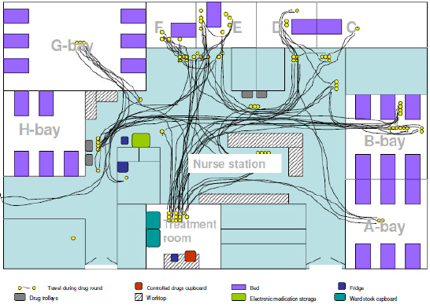
PHYSICAL PROCESS MAP
Spaghetti Diagram
Plot the path on a layout
Identify each step on the layout
Connect the steps
Measure / estimate the distance
Travel distance by one nurse during a drug administration round
Notes:
83

Slide 84
RUN CHART
Trend Chart
Medication Errors
900
800
700
600
500
dpm
400
300
200
100
0
2007
2008
2009
2010
2011
2012
2013
2014
Year
Notes:
84

Slide 85
RUN CHART (cont.)
ED Traffic Example
Note: Each line is a different day of the week
Number of Patients
Time of Day
Notes:
85

Slide 86
CONTROL CHARTS
Voice of the Process (VOP)
Q
U
A
L
Control limits extended
I
T
UCL
Y
+3σ
Control Region
Centerline
captures variation
M
natural to the
E
-3σ
original process
LCL
A
Process trend
Control limits
S
established
U
Special cause
identified
R
Process has shifted
E
S
TIME
Notes:
86
Specify value in the eyes of the Customer
Learn to see your processes from the perspective of your customer
Identify the value stream and eliminate waste/variation
Look at the combination of processes, not just a single process in isolation
Make value flow at the pull of the customer
Wait until you know what the customer wants before you start
Involve, align, and empower employees
Develop solutions using the people who are currently working in the process
Continuously improve knowledge in pursuit of perfection
Constantly challenge the organization to continue removing waste from processes

Slide 87
CONTROL CHARTS
Another Way to Look at Data
A management tool that monitors “health” of process
Data plotted in time sequence
Provide a systematic and efficient method for gathering data and transforming it into INFORMATION
Allow managers to make decisions based on FACTS
Highlight average, variation, outliers, shifts, and trends
Warn of system degradations giving managers time to prevent defects
Allow managers to be “predictive”
Show evidence of process improvements and helps sustain the gains
Signal problems but not their causes
See Appendix A
Notes:
87
Specify value in the eyes of the Customer
Learn to see your processes from the perspective of your customer
Identify the value stream and eliminate waste/variation
Look at the combination of processes, not just a single process in isolation
Make value flow at the pull of the customer
Wait until you know what the customer wants before you start
Involve, align, and empower employees
Develop solutions using the people who are currently working in the process
Continuously improve knowledge in pursuit of perfection
Constantly challenge the organization to continue removing waste from processes

Slide 88
PROJECTS
Manager’s Responsibilities
Identify a key project that will benefit work flow/process, etc.
Determine magnitude of project
  Time, resources, depth, potential cost, etc.
Align a belt (team leader) with the project and determine team members
Set goals for the project
Create and maintain project momentum
Meet with the belt regularly to ensure project completion
Conduct a tollgate for transitioning between each phase
Notes:
88

Slide 89
PROJECT TOLLGATES
Keep Projects on Track
Define
Measure
Analyze
Improve
Control
Stop
Tollgate Review
Stop
Tollgate Review
Stop
Tollgate Review
Stop
Managers/supervisors conduct tollgate reviews for transitioning between DMAIC phases (See Appendix B)
Tollgate Review
Stop
Tollgate Review
Notes:
89

Slide 90
PROJECTS (cont.)
Manager’s Responsibilities
Assist in identification and capture of “Return on Investment”
Break down barriers to project completion and push the project over the finish line
Recognize and reward success
Propagate success stories to generate cultural change
Notes:
90

Slide 91
ACHIEVING THE GOAL
Putting It Together
Information
Knowledge
Patient Satisfaction
Data
Metrics
VOP
VOC
Questions
Analyze Work
Continuous Improvement
Projects
Value Stream and Process Improvement
Critical
Thinking
Lean Tools
Notes:
91

Slide 92
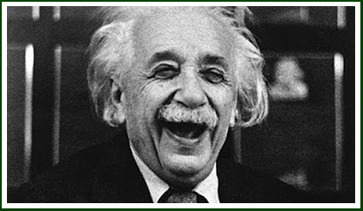
TIME TO DO THINGS DIFFERENTLY
Are You Hitting the Improvement Barrier?
Albert Einstein
(1879-1955)
Insanity:
“doing the same thing over and over again and expecting different results”
Notes:
92

Slide 93
READINESS FOR CHANGE
A Normal Distribution
CAVE People:
Nothing in the world will empower
these. Seal off the cave so none
of the 80% drift in.
Settlers:
Training alone will not empower these.
Pioneers:
Training alone can
empower these.
CAVE People
.80
.10
.10
To move an organization forward, management must act on these, setting/declaring expectations and
aligning the rewards and recognition strategy with accountability and expectations.
Notes:
93

Slide 94
SUCCESSFUL CHANGE
Key Ingredients
DD + VF + FS > R *
  Degree of Dissatisfaction (Need)
  DD =
  VF =
  FS =
  R =
  Vision for the Future (Vision)
  First Step (Plan)
  Resistance to Change
* Change Model used with permission from Kelly and Frank Petrock.
Notes:
94

Slide 95
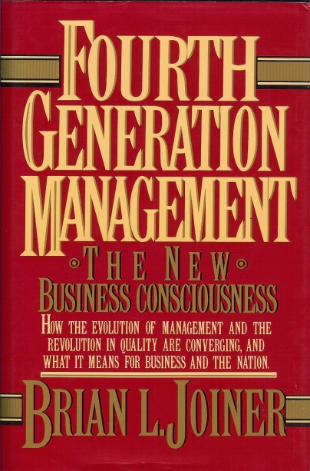
MANAGEMENT STYLES
Which is Yours?
Management by Doing - (1st Generation)
  Simplest, most primitive approach
  Managers do the work themselves
  Effective way to get things done; limited in capacity
Management by Directing – (2nd Generation)
  Managers tell workers what to do and how to do it
  Work performed by employees
  Maintains strict compliance to standards
  Close supervision and detailed directions
Notes:
95

Slide 96
MANAGEMENT STYLES (cont.)
Which is Yours?
Management by Results - (3rd Generation)
  Managers tell employees what needs to be accomplished
  Employees determine how to accomplish the work
  Focus is on judging and rewarding people on outcomes
  Workers seldom provided with the knowledge or skills needed to improve the system
  Expected results achieved at the expense of other results
4th Generation Management
  Managers care about results and know that the best way to achieve them is through fundamental improvement
  Managers become the champions of customer needs
  Managers become the drivers of real improvement
  Managers work with process workers as “partners” to develop better methods to achieve better results
Notes:
96

Slide 97
“ADDITIONAL” MANAGER ROLES
Drive Continuous Improvement
Problem Solver
  Enlist the “right” people
  Determine the data to collect
  Organize for data collection
  Collect the data
  Use the appropriate tools to solve the problem
Motivator
  By word and example
  Out of the office and on the floor
  Give credit where it’s due
  Talk the language of the process workers
Notes:
97

Slide 98
“ADDITIONAL” MANAGER ROLES (cont.)
Drive Continuous Improvement
Chief “Change Agent”
  Perform self-assessment
  Encourage questions
  Communicate need, vision, and plan
  Deploy necessary resources
  Support change
  Take time to coach (individuals and teams)
  Teach Lean principles and methods
  Be engaged!
Notes:
98

Slide 99
ROADMAP
Managers Create and Implement
What is the need for Lean?
What is the vision for the future?
  Short-term (1 year)
  Long-term (1-3 year)
What is the plan to achieve the vision?
How can our Lean deployment/efforts fail?
What can we do to be successful?
VSM
Process Flow
Kaizen/RIE
Gemba
Metrics
Prioritization
5S
Notes:
99

Slide 100
IMPROVEMENT REQUIRES BEHAVORIAL CHANGE
Lean Transforms
Lean Challenges Us To:
  Think Differently
  Work Differently
  Ask Questions and Challenge the Status Quo
  Make Decisions With Facts and Data
  Use New Principles, Tools and Methodologies
When Culture and Need for Change Compete …
Real Leaders and Managers are Needed
Notes:
100

Slide 101






Thank You – For More Information, Please Contact:
Air Academy Associates, LLC
1650 Telstar Drive, Suite 110
Colorado Springs, CO 80920 USA
Call: (800) 748-1277 or (719) 531-0777
Facsimile: (719) 531-0778
Email: aaa@airacad.com
Website: www.airacad.com

